Slide 1
Waggle-FCP-FDF
Subba Reddy Jangalapalli
Dinesh Reddy Chandupatla
Sashikiran Kandra
Srinivasa Rao Vunnam
September 2022

Slide 2
Problem Statement
As we all know that customer sales are key in Walmart, it directly impacts to P & L.
Our intention is to increase the sales and save money, live better; make customer happy and keep Walmart thriving. Walmart is huge, and each department itself is a mini company.
At each Dept Level – reduce wastage, avoid excessive inventory, increase sales and plan & forecast well in advance by using history data and macroeconomic factor signals (for example: COVID, DR, Any NEW, etc.)
Trying to identify which ML model/technique will be best suited for each department level or group of departments based on macroeconomics. Examples:
Produce (Dairy, Meat, Grocery, etc.)[Dept# 81,90,91,92,93,94,97 &98]
Fuel [Dept#42 & 65]
GM (General Merchandise) & Other (non-produce & non-fuel) [Dept# non aforesaid dept list]
Plan & Forecast well in advance at each department level in Regular/Seasonal/DR/New scenarios.
Address UPI issues (Reduce unnecessary ships/over orders to avoid excessive inventory )
Address OPI issues ( Sales Lift, retain regular customers)
Flexibility to use best ML Model/Technique based on Departmental level dynamics in ML Factory.

Slide 3
Impact on Walmart
Sales & Planning well in advance with accuracy forecasting at each Dept Level, and proactive actions based on market situations and/or economic conditions.
Avoid excessive inventory (~270M, ~$5 = $1.35B)
Reduce throws (~$80K, ~5000 stores = $4M)
Sales Lift (~$2.8M) & Ships reductions(~$4.6M) , increase net sales & revenue – Forecast well in advance
Sustain repetitive customers by having OH available on sales floor

Slide 4
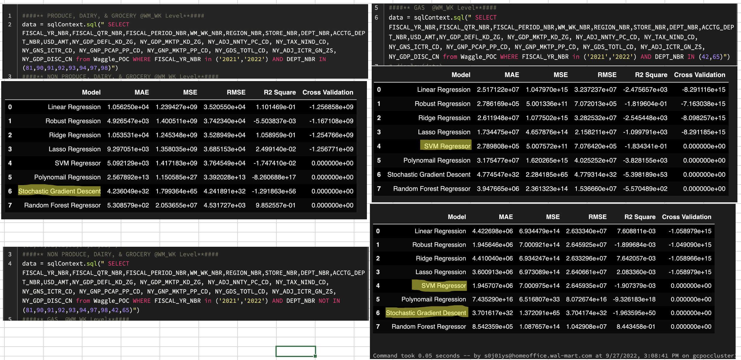
The Solution
POC developed with limited history by using BQ & Data Bricks notebook to identify which ML model/technique works well for which are all departments or set of departments. Week level Sales –

Slide 5
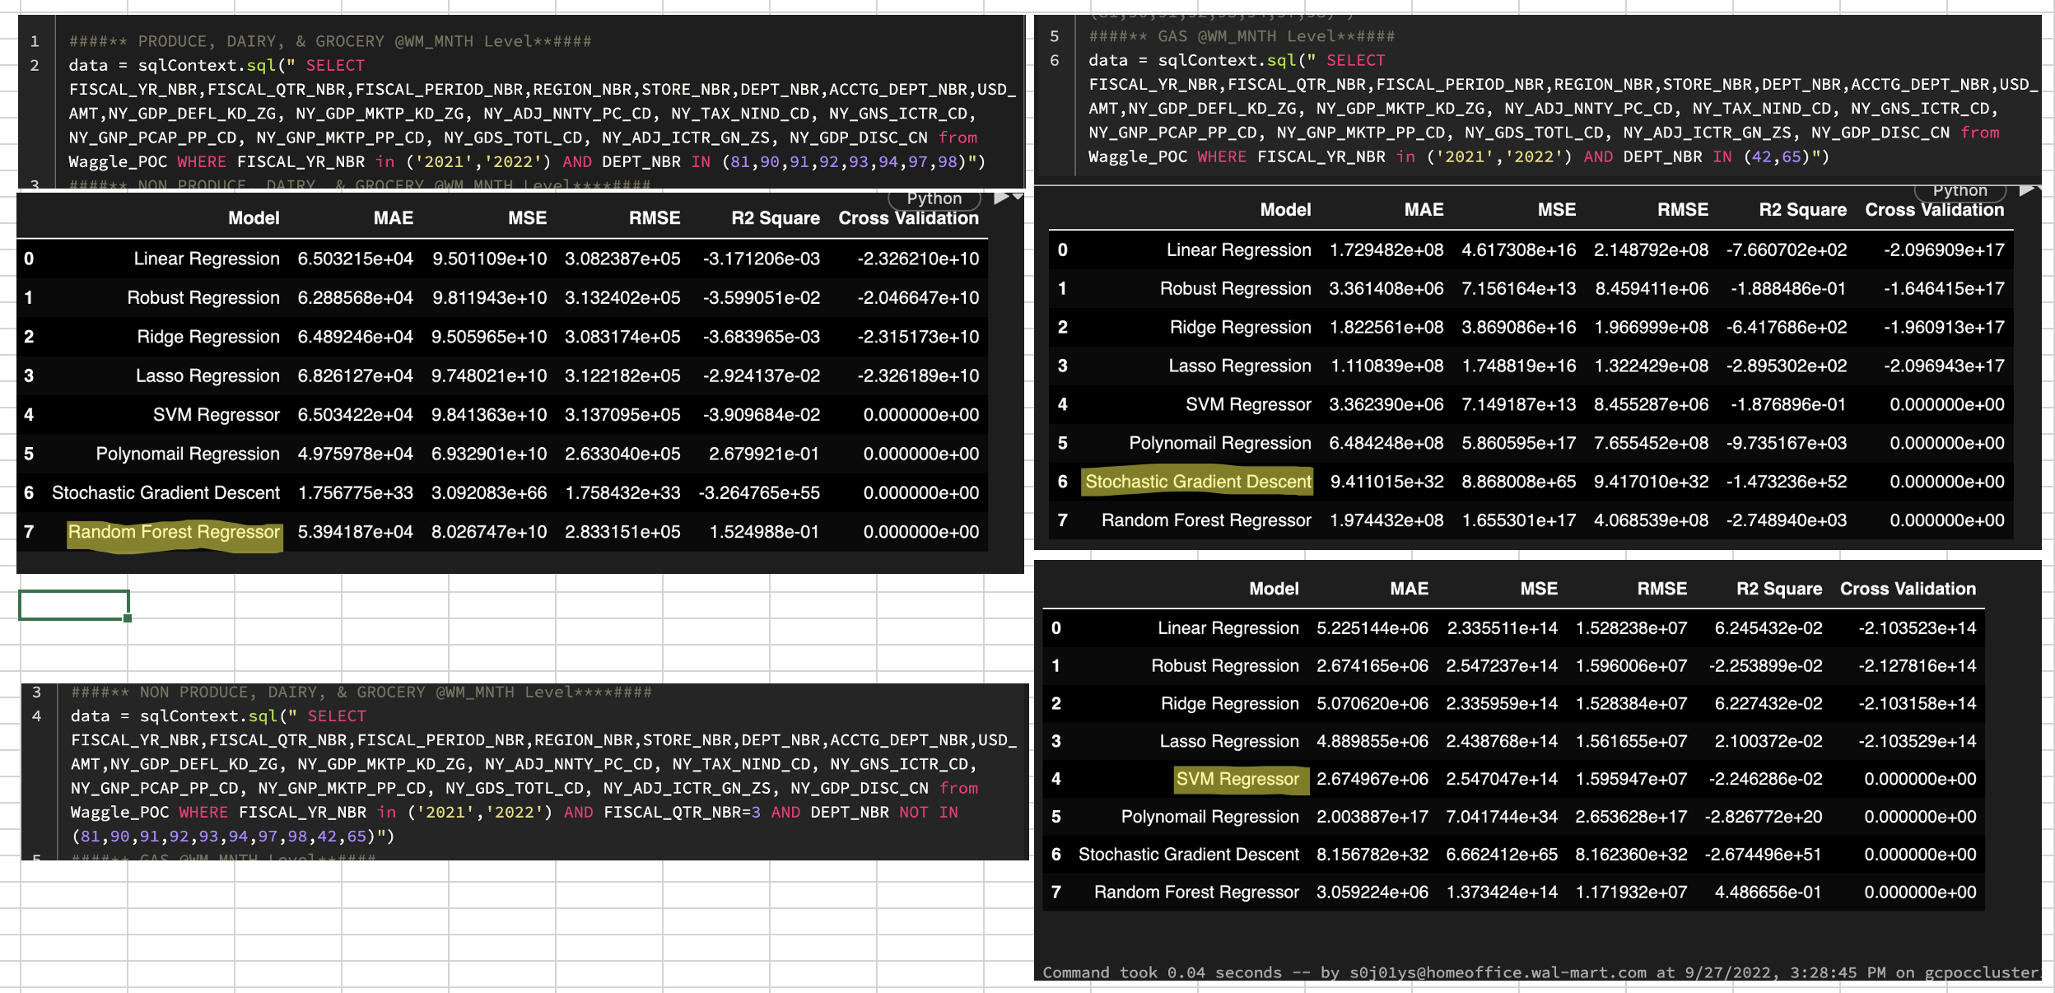
The Solution
POC developed with limited history by using BQ & Data Bricks notebook to identify which ML model/technique works well for which are all departments or set of departments. Monthly Sales –

Slide 6
Demo of the Solution
Live Demo by using BQ & Data Bricks notebook
Please mention the details on the technologies driving the solution or used to build the product: Weekly sales, Monthly sales, BQ, AIML & DB Cluster & Notebooks
How does this solution solve the problem: Granular level [Dept vs week/month/quarter/year vs location(store/County/State/Region)] accurate predictions with specific ML model/Technique from WM ML Factory
What are it’s unique selling points? Ships reductions, avoid excessive inventory, reduce throws & Sales lift; which internally leads to net sales, revenue & profit increases and accurate planning & forecast at each Dept/store/state/region Level

Slide 7
Future Roadmap
Build solid history of data with 100% accuracy signals and economic factors(at least 3 years of data to start) to respective market.
Real Time Inventory (SI, PI, RC, BR, TR, MS, etc. Along with LOC details)
Real Time Micro economic factors
Real Time Weather data
Build, Train, & Evaluate ML models at granular level at different dimensions with flexibility of to add noisy buffers while triggering; like regular, seasonal, BTS(Back2School), STE(Sales Tax Exemption), DR situations and new/remodeling @State/County level – various variety ML models are in as ML Factory
Have CV check on every schedule run of each ML model, if running average success threshold breaches or prediction accuracy levels are not as expected then retrain & evaluate the Model (ML Ops)
Resources:
Dedicated GPU Cluster
Engineers who are passionate about data, AIML, and ML Ops

Slide 8
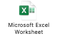
Links to Code/Simulations/others - Mandatory
GitHub Link : https://github.com/jangalapallisr/AIMLPOC/blob/main/WagglePOC.py
DATA BRICKS Note Book: https://adb-3587475191488340.0.azuredatabricks.net/?o=3587475191488340#notebook/3633583601294042/command/3633583601295787
Want to thank to Anshul Bansal (@DS Team for help & mentor), and special thanks to my leadership team (Srinivas Kasavaraju & Ryan Booth ) for support & opportunity to participate in Hackathon and explore.

